Slide 1



Hardware and Software Fundamentals of
Intelligent Computing
Systems

Slide 2
Lecture 35: GPU Memory Optimization Techniques

Slide 3
Outlines
Background
  Training ultra-large language models incurs enormous GPU memory overhead
GPU Memory Optimization: Gradient Checkpointing (Activation Recomputation)
  Discard most intermediate activations from the forward pass, and when needed during the backward pass, temporarily recompute them from the nearest checkpoint.
GPU Memory Optimization Method: Offloading (Data Offloading)
  Leverage Host Memory as an extension of GPU Memory, taking advantage of its lower access frequency but enormous capacity.
  ZeRO-Offload: Offload optimizer states and gradients to CPU. Utilizing CPU for weight update, as this operation places relatively low demands on compute but accounts for an exceptionally large share of GPU Memory consumption.
  ZeRO-Infinity: further supports offloading model parameters to NVMe SSD. Through asynchronous prefetching and bandwidth optimization, it enables training of trillion-scale models
Notes:
GPU Memory Optimization Techniques: Gradient Checkpointing (Activation Recomputation), Offloading (CPU Offload).
Gradient Checkpointing
Basic: https://github.com/rasbt/deeplearning-models/blob/master/pytorch_ipynb/mechanics/gradient-checkpointing-nin.ipynb
https://www.newline.co/@zaoyang/fine-tuning-llms-with-gradient-checkpointing-and-partitioning--42a48e66
Offloading
ZERO-Offload: https://www.usenix.org/conference/atc21/presentation/ren-jie
ZeRO-Infinity: https://arxiv.org/abs/2104.07857
Others
Parameter Compression, Distributed Sharding, and Memory Management

Slide 4
Background: LLM Training GPU Memory Overhead
Dimension | GPT-3 (175B)
GPU Scale | ~10,000 A100s
Training Duration | ~34 days
Total Power Consumption | ~1.287 million kWh
Carbon Emissions | ~502 tons CO2e
GPU Memory Overhead | ~350 GB (parameters)
Total Training GPU Memory | ~2.8 TB
Estimated Total Cost | ~$10M - $20M
Exponential Growth in Model Scale
  From GPT-3 (1750 billion parameters) to GPT-4 (trillion-scale parameters)
  For a 100B model with 200GB of parameters, full training requires approximately 1.6TB ~ 2TB of GPU Memory
Real-World Challenges Caused by Insufficient GPU Memory
  Training infeasible: a single GPU cannot load the model, making distributed training mandatory
  Soaring costs: multi-GPU parallelism introduces communication overhead, making linear speedup difficult to achieve
  Sequence length constraints: long-context (>8K tokens) GPU Memory overhead grows quadratically
Component | Estimated Proportion | Description
Model Parameters | ~20-30% | Weight matrices (FP16/BF16 precision)
Optimizer States | ~40-60% | Adam requires storing momentum + second moments (FP32)
Gradients | ~20-30% | Backward Pass Gradient Cache
Activations | Variable | Dominant for long sequences (proportional to square of seq length)
GPT-3 Training Cost Estimate
Dimension | GPT-4 (1.8T rumored scale)
GPU Scale | ~25,000 A100s
Training Duration | 90 - 100 Days
Total Power Consumption | ~51.77M - 62.31M kWh
Carbon Emissions | ~1,035 - 14,994 Tons CO2e
GPU Memory Overhead | ~3,600 GB (Parameters)
Total Training GPU Memory | ~20 TB+
Estimated Total Cost | $100M - $500M USD
GPT-4 Training Cost Estimate

Slide 5
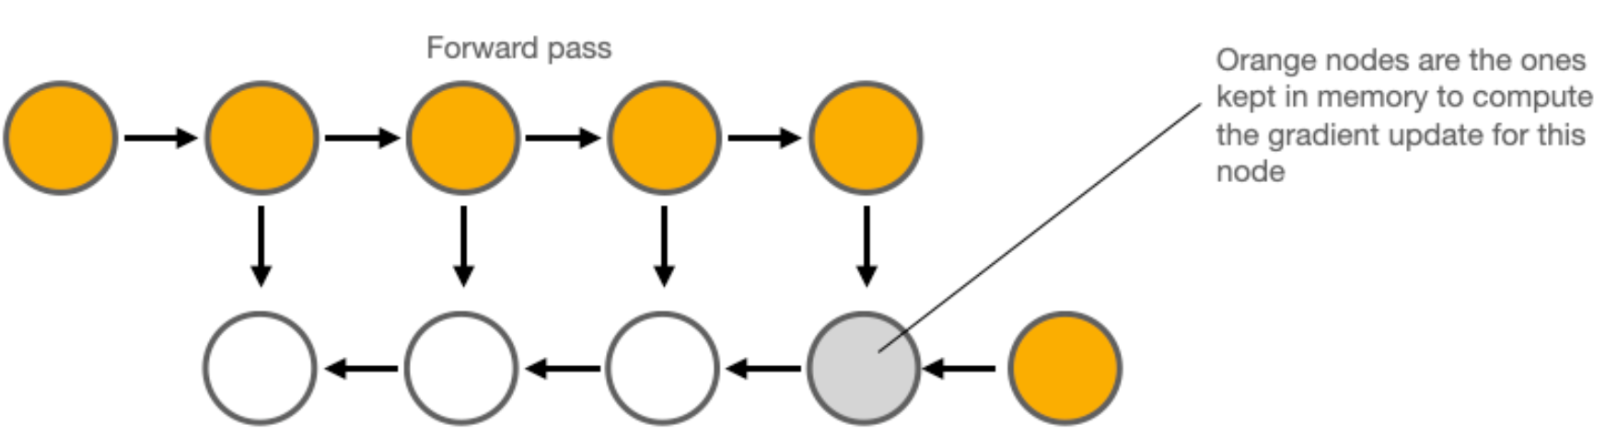
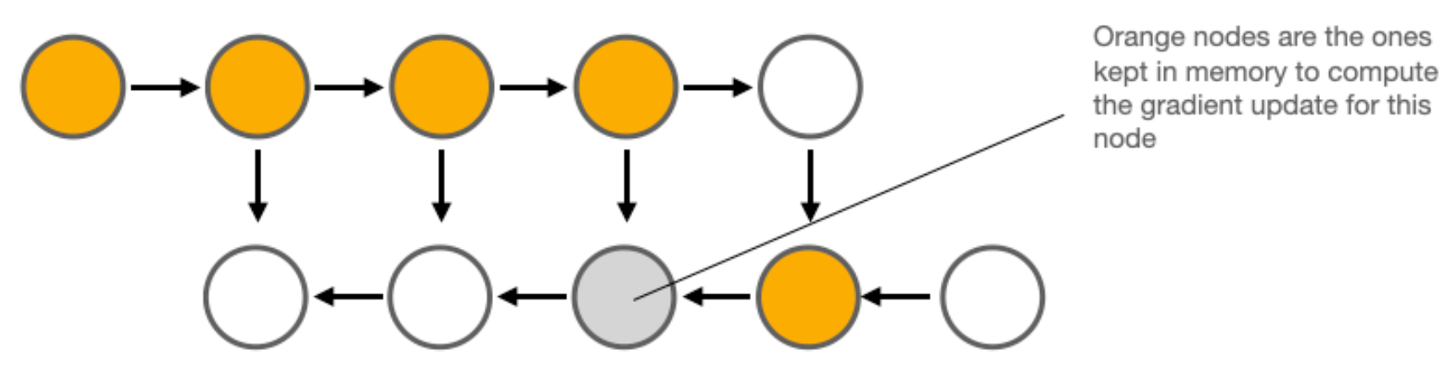
Background: Memory Mechanisms of the Backward Pass
Standard Backward Pass (Vanilla)
  Memory requirements grow linearly with the number of network layers
Root Cause Analysis
  Node Retention: All intermediate activations generated during the forward pass must be retained in memory.
  Dependency: When computing the gradients for layer i , the input and output of layer i are typically required.
  Release condition: The corresponding memory is only released after all child nodes (dependencies) have been fully processed.
Forward Pass: All intermediate activations must be retained in memory
Backward Pass: Once child nodes have been processed, the corresponding memory is released
Notes:
https://github.com/rasbt/deeplearning-models/blob/master/pytorch_ipynb/mechanics/gradient-checkpointing-nin.ipynb

Slide 6
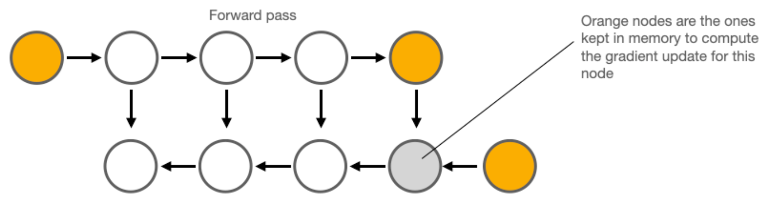
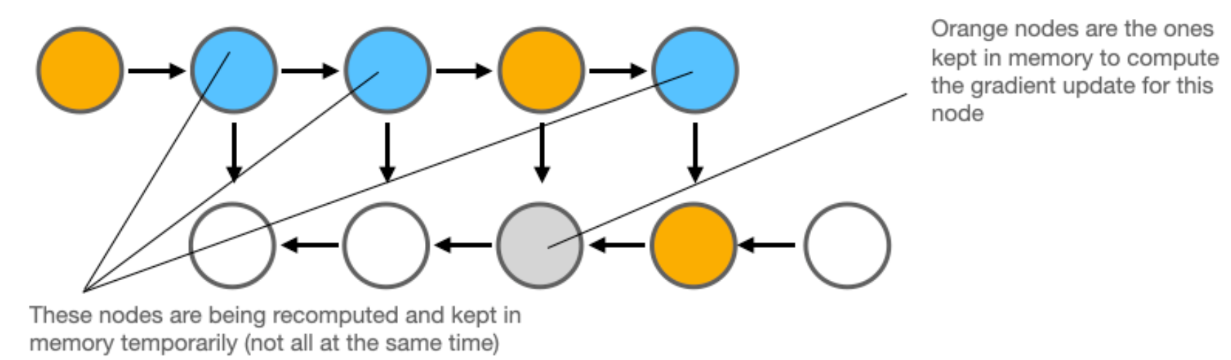
Background: Memory Mechanisms of the Backward Pass
Low-Memory Backward Pass
  Discard intermediate values and recompute them on demand.
Basic Workflow
  No longer store all activations from the forward pass in memory.
  When the backward pass requires data from a certain layer, rerun the forward computation from the nearest checkpoint.
  Computational complexity increases from O(n) to O(n^2)
Forward Pass: Does not store the Activations of the Forward Pass in memory
Backward Pass: Re-runs the forward computation from the nearest "Checkpoint"
Notes:
https://github.com/rasbt/deeplearning-models/blob/master/pytorch_ipynb/mechanics/gradient-checkpointing-nin.ipynb

Slide 7
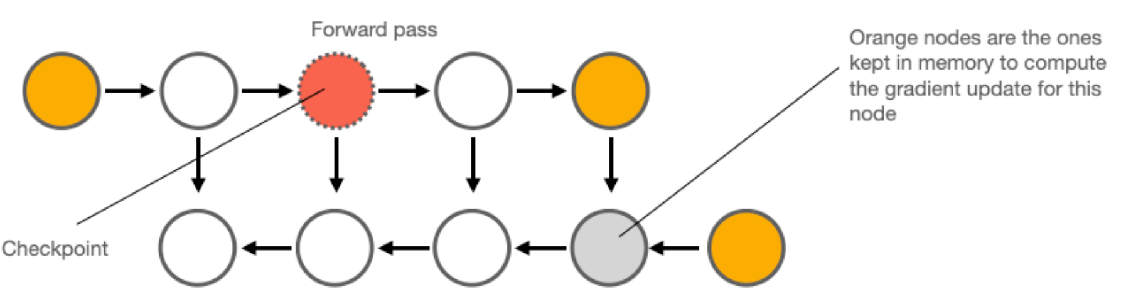
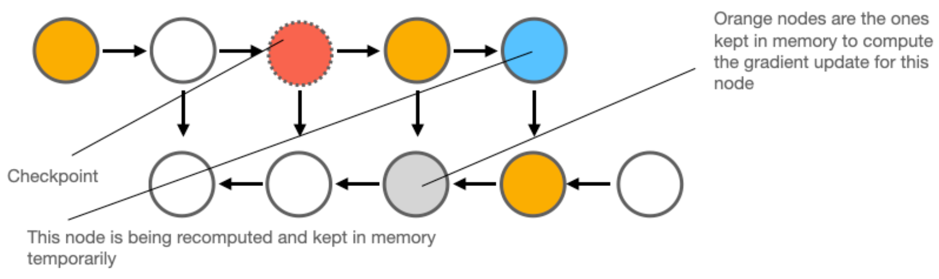
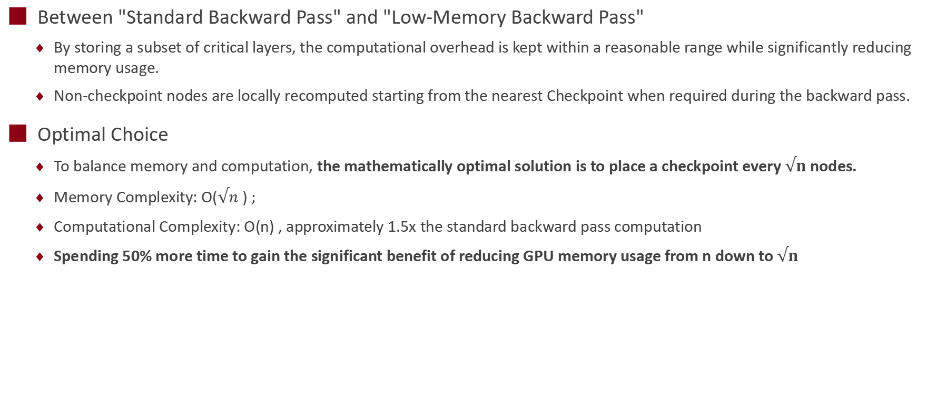
Gradient Checkpointing
Between "Standard Backward Pass" and "Low-Memory Backward Pass"
  By storing a subset of critical layers, the computational overhead is kept within a reasonable range while significantly reducing memory usage.
  Non-checkpoint nodes are locally recomputed starting from the nearest Checkpoint when required during the backward pass.
Optimal Choice
  To balance memory and computation, the mathematically optimal solution is to place a checkpoint every $√n$ nodes.
  Memory Complexity: O($√n$ ) ;
  Computational Complexity: O(n) , approximately 1.5x the standard backward pass computation
  Spending 50% more time to gain the significant benefit of reducing GPU memory usage from n down to$√n$
Forward Pass: store partial key layers
Backward Pass: perform local recomputation starting from the nearest checkpoint

Slide 8
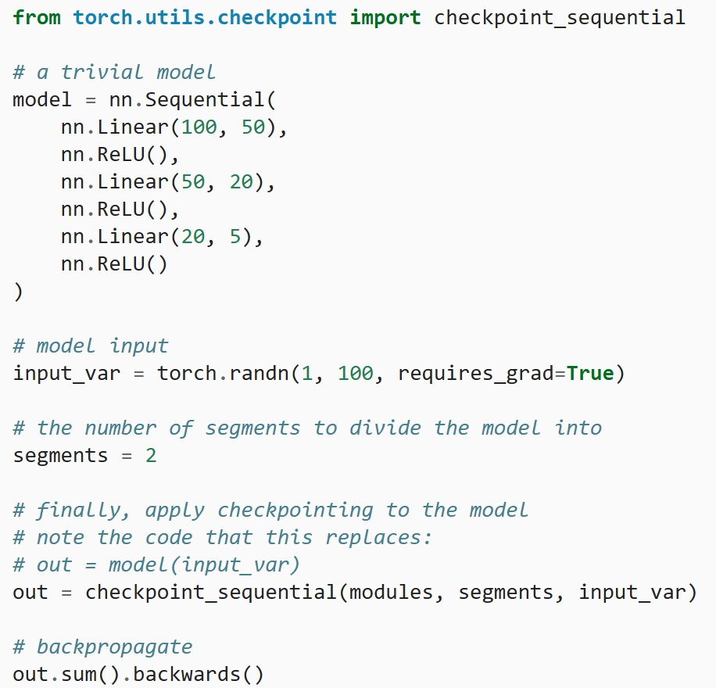
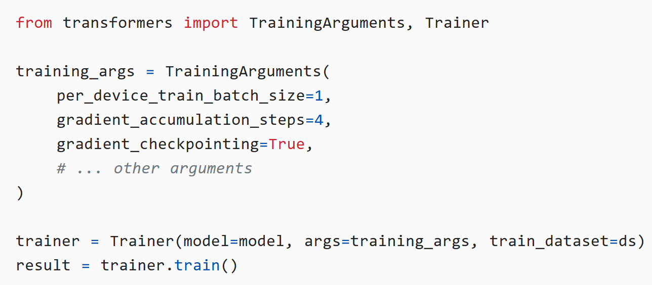
Gradient Checkpoint Code
Native PyTorch custom implementation
  Core module: torch.utils.checkpoint
  For general models: use the checkpoint function, which can wrap any nn.Module.
  For sequential models: use checkpoint_sequential, designed specifically for nn.Sequential, with built-in support for automatic segmentation.
Hugging Face Simple Model Integration
  Enable the gradient_checkpointing flag in training parameters
Native Pytorch Implementation Checkpoint
HF Simple Model Integration Checkpoint
Notes:
https://residentmario.github.io/pytorch-training-performance-guide/gradient-checkpoints.html
https://www.newline.co/@zaoyang/fine-tuning-llms-with-gradient-checkpointing-and-partitioning--42a48e66

Slide 9
Offloading
Principle
  By temporarily migrating model parameters, optimizer states, or activations from GPU GPU memory to CPU memory or NVMe storage, the GPU Memory capacity constraint is overcome, enabling training of larger models.
Core Motivation
  Offload inactive parameters to CPU/Disk
  Computation and storage are tiered
  Dynamic swap-in and swap-out
Key Techniques
  ZeRO-Offload (DeepSpeed): Offload optimizer states and gradients to CPU memory
  ZeRO-Infinity: Scaling to NVMe SSD, Supporting TB-Scale model training
  FSDP + CPU Offload (PyTorch): Based on Fully Sharded Data Parallel, supports partial offloading after parameter sharding
Dimension | Impact | Optimization Strategies
Communication Overhead | CPU↔GPU bandwidth is far lower than GPU Memory bandwidth | Prefetching, computation-communication overlap
Computation Latency | CPU computation is slower than GPU | Offload only the optimizer states (e.g., adam computation), keeping forward/ backward passes on the GPU
Scalability | NVMe bandwidth limitation | Multi-channel SSD parallelism, asynchronous I/O

Slide 10
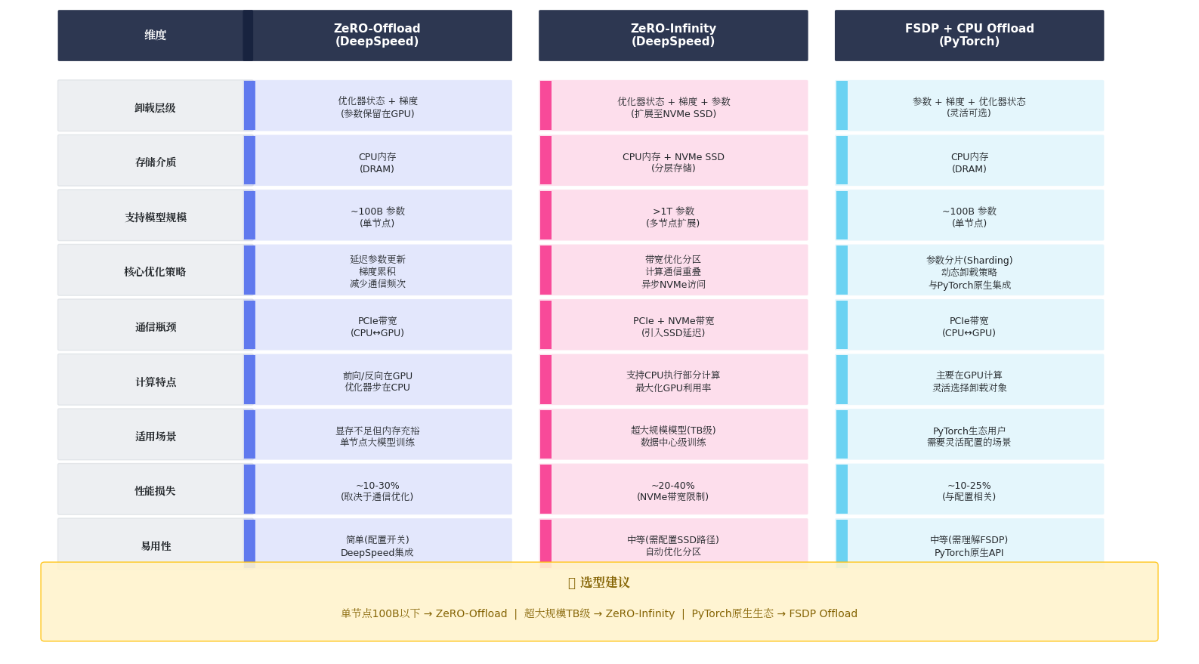
Large Model Training Offloading Technology Comparison
Notes:
Generated by Kimi 2.5

Slide 11
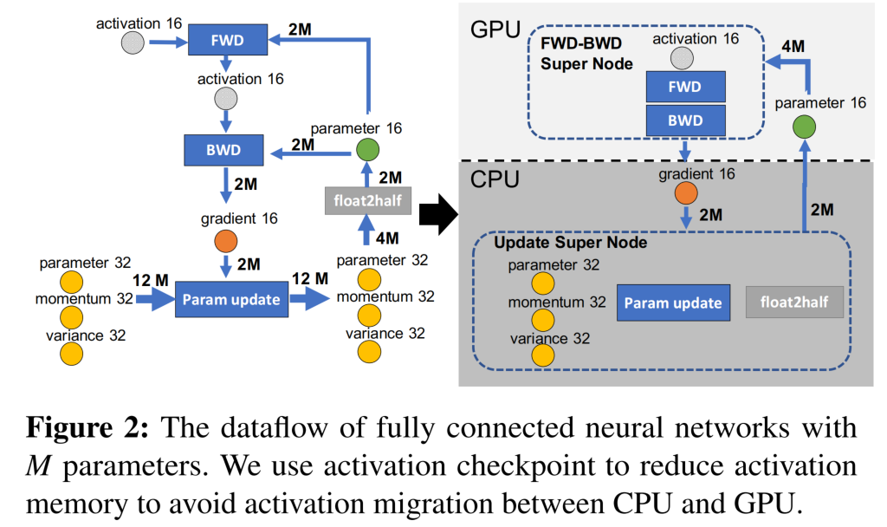
DeepSpeed ZeRO-Offloading
Strategy 1: Limit CPU Computation
  CPU computation is far slower than GPU; only offload low-complexity tasks.
  GPU retains: forward and backward pass (complexity O(MB), where B is Batch Size).
  CPU handles: parameter updates (complexity O(M)), such as norm computation, weight update, etc.
Strategy 2: Minimize Communication Volume
  The minimum communication volume for any model state offloading scheme is 4M
  p32, m32, v32 are merged with the "weight update" computation
  p16 and FWD-BWD super-node remain together on the GPU
Node Type | Device | Reason
FWD-BWD Super Node | GPU | Extremely high computational demand O(MB)
p16 | GPU | Reduce communication overhead with compute nodes
Update Super Node (p32, m32, v32) | CPU | Highest memory footprint, with low computational complexity (O(M)
g16 | CPU | Reduce communication overhead with compute nodes

Slide 12
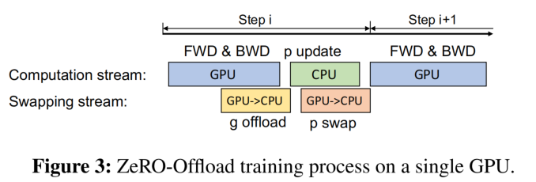
ZeRO-Offloading Single-GPU Scheduling
Computation and Communication Overlap
Forward Pass
  FP16 parameters are already on GPU ; no communication with CPU is required.
Backward Pass
  On-the-fly transfer: Gradients are immediately sent to CPU in small groups as soon as they are computed.
  Pipeline parallelism: leverages asynchronous transfer to overlap gradient back-propagation with the remaining backward computation, hiding communication overhead.
Update Phase
  Directly update FP32 states (parameters, momentum, and variance) on the CPU.
  After the update, only convert the FP32 parameters back to the GPU and update them to FP16.

Slide 13
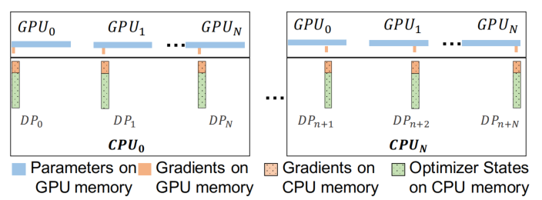
ZeRO-Offloading Multi-GPU Scaling
Combining ZeRO-2 "state partitioning" with Offload "path redirection ".
Data Layout
  Each GPU is only responsible for maintaining a partition of the parameters, gradients, and optimizer states.
  The partition corresponding to each GPU is offloaded to its connected CPU memory.
Parallelism Advantage
  Constant Communication: The total communication volume does not grow as the number of GPU units increases.
  Compute Acceleration: Optimizer updates on the CPU side are processed in parallel across multiple CPU cores.
  The more GPUs are used, the less CPU computation each card shoulders, delivering exceptional scalability.
ZeRO-Offload data placement with multiple GPUs

Slide 14
ZeRO-Infinity Features and Capabilities
Key Features
  Unlimited Scale: Supports training models with hundreds of trillions of parameters on limited GPU resources
    For example, training a model with over 1 trillion parameters on a single GPU node.
  Extreme Heterogeneous Utilization: Treats HBM, DRAM, and NVMe as a unified memory hierarchy.
  Compute Communication Overlap: The Infinity Offload Engine mitigates the low-bandwidth impact of NVMe/PCIe.
  Ease of Use: No model refactoring required; developers can train large models just as writing PyTorch code.
Core Features
  ZeRO-3 All-Round Optimization: Eliminate redundancy entirely by distributing parameters, gradients, and optimizer states across all heterogeneous storage media.
  NVMe Memory Expansion: Leverage NVMe storage for optimizer states and weights, breaking through the capacity constraints of DRAM.
  Efficient Prefetching Mechanism: Prefetch the required parameters from slow storage (NVMe/CPU) before computing the next layer.
  Data Parallelism and Operator Splitting： Supports automatic splitting of extremely large operators, ensuring that a single GPU can fit even the most massive network layers.

Slide 15
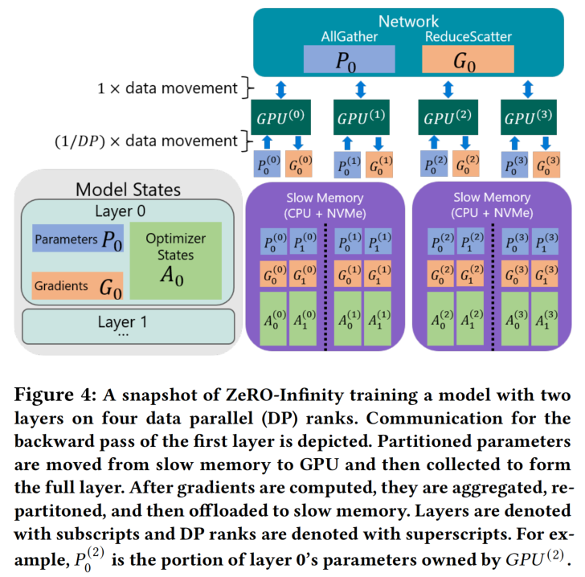
ZeRO-Infinity Overall Workflow
Step 1: Parameter Fetching
  Each GPU holds only a small shard of the parameters for that layer.
  The sharded parameters are moved from slow storage into the GPU memory of the corresponding device.
Step 2: All-Gather
  The complete parameters of the Layer are temporarily assembled in the GPU memory of every device.
Step 3: Gradient Computation and Aggregation
  The backward pass is performed using the complete parameters to generate gradients.
  Each GPU ultimately retains only the shard of gradients it is responsible for.
Step 4: Gradient Write-Back
  The aggregated gradient shards are written back from GPU memory to slow storage.

Slide 16
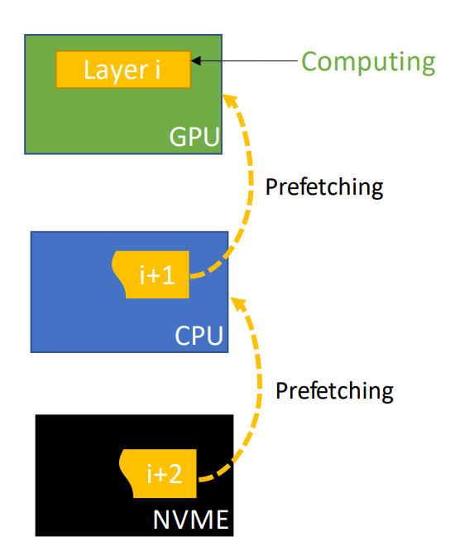
ZeRO-Infinity Efficiency Optimization
1. Bandwidth-Centric Parallel Partitioning
  Abandon ZeRO-Offload single-owner/broadcast model, and store each parameter as shards
  distributed across all DP rank nodes.
  Parallel PCIe throughput: Engaging all PCIe lanes across all nodes simultaneously for parallel reads,
  with effective bandwidth scaling linearly with the DP degree.
2. Full End-to-End Pipeline Overlap Design
  Three-Level Prefetch Engine: NVMe → CPU, CPU → GPU, and GPU ↔ GPU.
    Example: While executing operator i, concurrently prefetch the GPU communication for i+1, the GPU Memory copy for i+2, and the disk read for i+3.
  Dynamic Flow Awareness: Builds operator mapping tables in real time, supporting complex or dynamically changing computation graphs to mask data movement overhead.
3. Infinity Offload Engine and Optimizations
  DeepNVMe Library: A high-performance C++ asynchronous I/O library that achieves maximum NVMe read/write performance through request parallelization, intelligent scheduling, and zero-copy technology.
  Pinned Memory Management:
    Minimal memory footprint: Only tens of GB of pinned buffers are required to manage tens of TB of model states, completely eliminating memory fragmentation.
    In-place Computation: Supports optimizer updates directly within buffers, eliminating unnecessary memory copies and improving end-to-end throughput.
Notes:
https://raw.githubusercontent.com/microsoft/DeepSpeed/master/docs/assets/files/SC21-ZeRO-Infinity.pdf

Slide 17
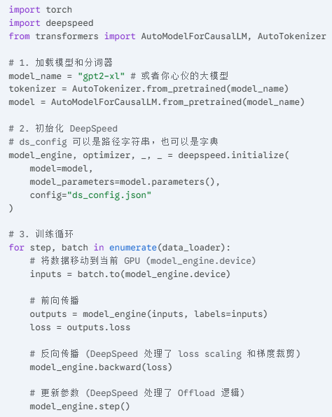
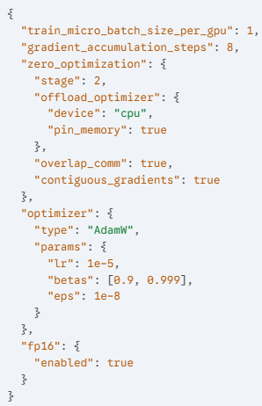
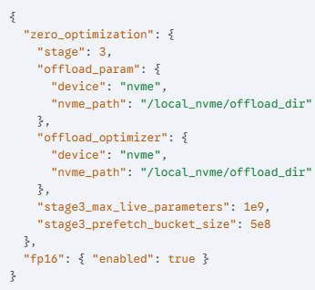
DeepSpeed ZeRO-Offloading & Infinity Code Examples
DeepSpeed Configuration
ZeRO-Offload (Stage 2)
DeepSpeed Configuration
ZeRO-Infinity (Stage 3 + NVMe)
Training Code Examples

Slide 18

The Solution: FlagOS, a Unified AI Software Stack

Slide 19








https://space.bilibili.com/3546791834290849
https://github.com/flagos-ai
https://www.zhihu.com/people/95-22-20-18/posts
https://flagos.io/Home

Slide 20

Thanks for your time！

